Slide 1


Group 3
Diaper Changers
Incorporated
Founded by:
-Leng Chan Raksmey
-Kheam Thailong
-Vong Khoy Khun

Slide 2


Group 3
Our Objectives
1.Introduction
2.Swot Analysis
3.Conclusion

Slide 3
Group 3
Introduction
Diaper changers, Inc is a family friendly company that cares for your children's care and does the most to help reserve our beautiful planet so that your children can live long prosperous lives in the unpolluted future.
We provide a service of caring for your children 24/7 from the ages of 0-5. This includes changing their diapers (with our eco-friendly biodegradable ones) and all other different methods for baby care as our employees are thoroughly trained and will be the best choice for you and your children.

Slide 4
SWOT ANALYSIS

Slide 5


STRENGTHS
WEAKNESSES
-Fast and reliable service
-New business
-Selling a service + product
with a cause!
-Lack of funding
-Thoroughly trained staff
-Slow early production

Slide 6

Opportunities
-Expand market
-Collaboration with Daycare Center
-Partnership with Maternity Clinic
-Educational campaign
-Provide a subscription plan

Slide 7
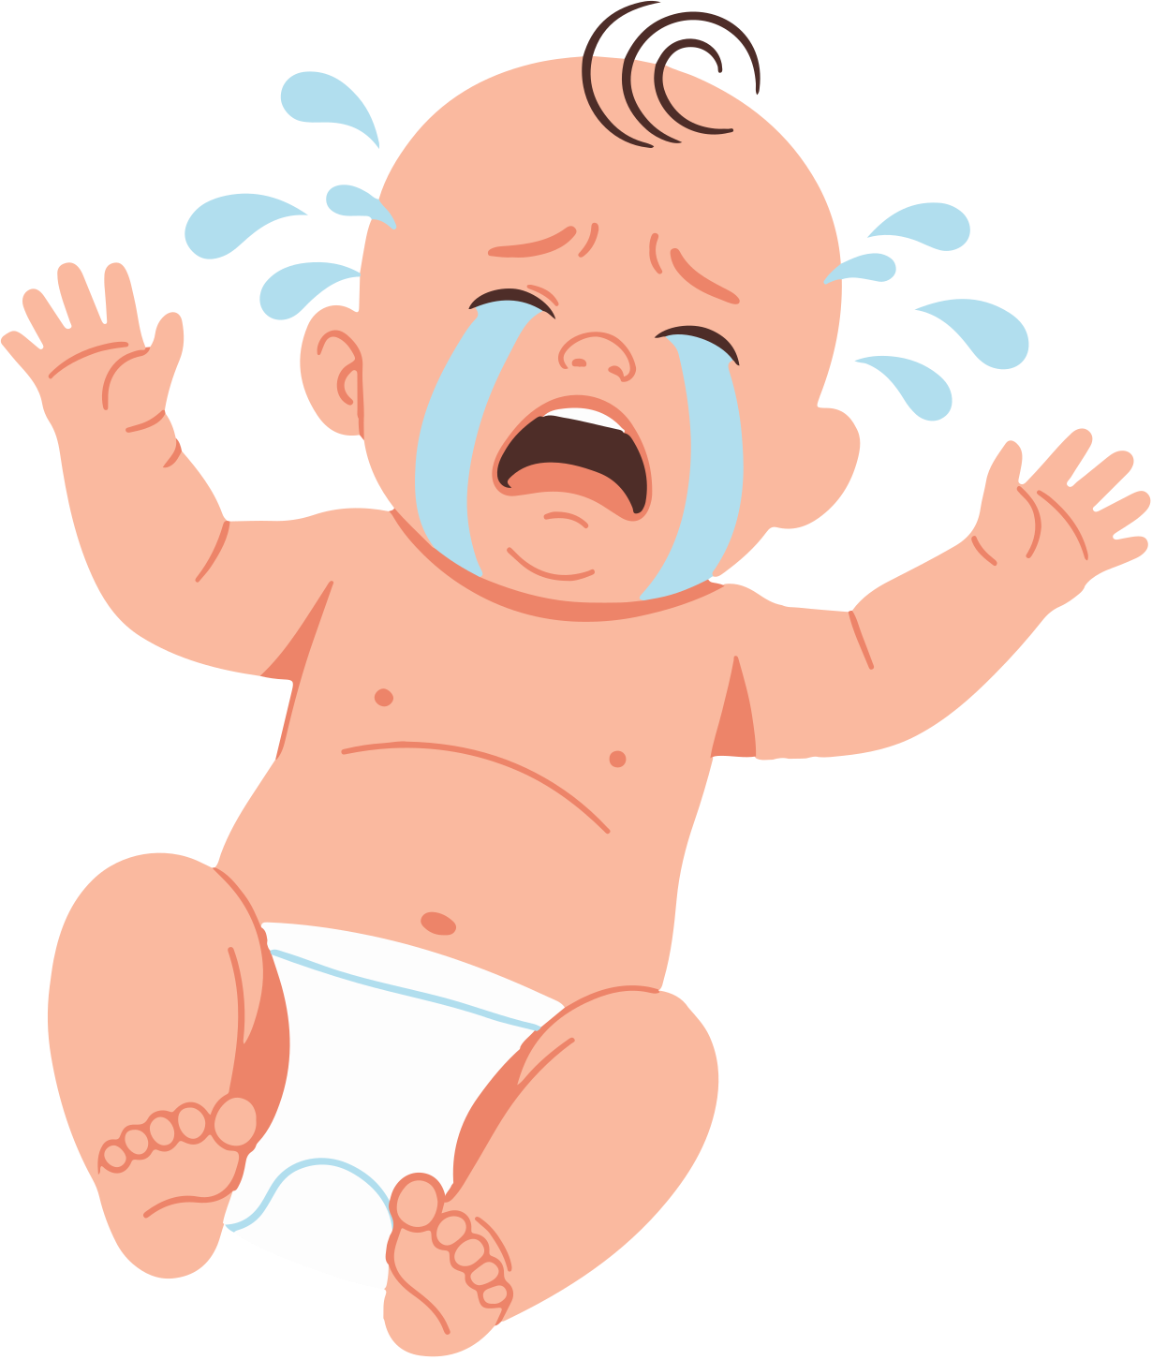
Threats
-Competition
-Customer skepticism
-Supply chain risks
-Overdemand (Understaff)

Slide 8


Conclusions
1.
We are not just selling biodegradable diapers
2.
we are also providing services
3.
as well as babysitting to assist busy parents.

Slide 9
Thank You !

